Slide 1
Experiment 2
Simple Harmonic Oscillations
PHYS 365 & 369

Slide 2
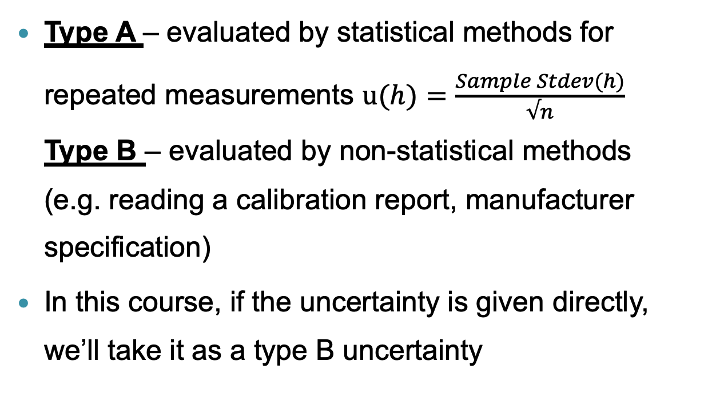
Clarification for definition
Type A vs. Type B uncertainty
Type A – evaluated by statistical methods for repeated measurements $u(h)=\frac{Sample Stdev(h)}{√n}$ Type B – evaluated by non-statistical methods (e.g. reading a calibration report, manufacturer specification)
In this course, if the uncertainty is given directly, we’ll take it as a type B uncertainty

Slide 3
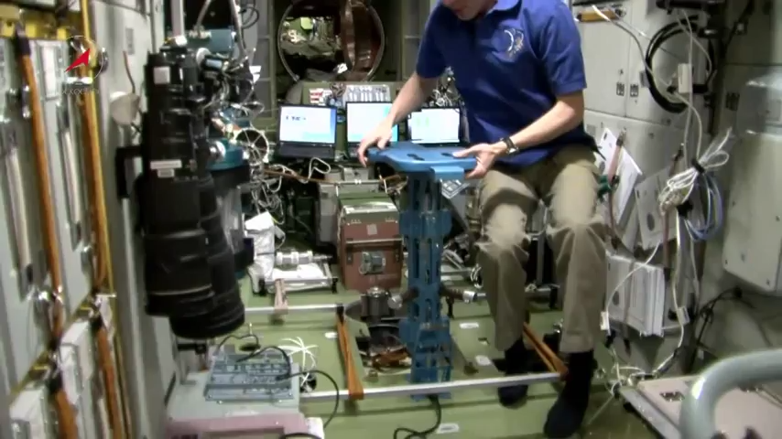
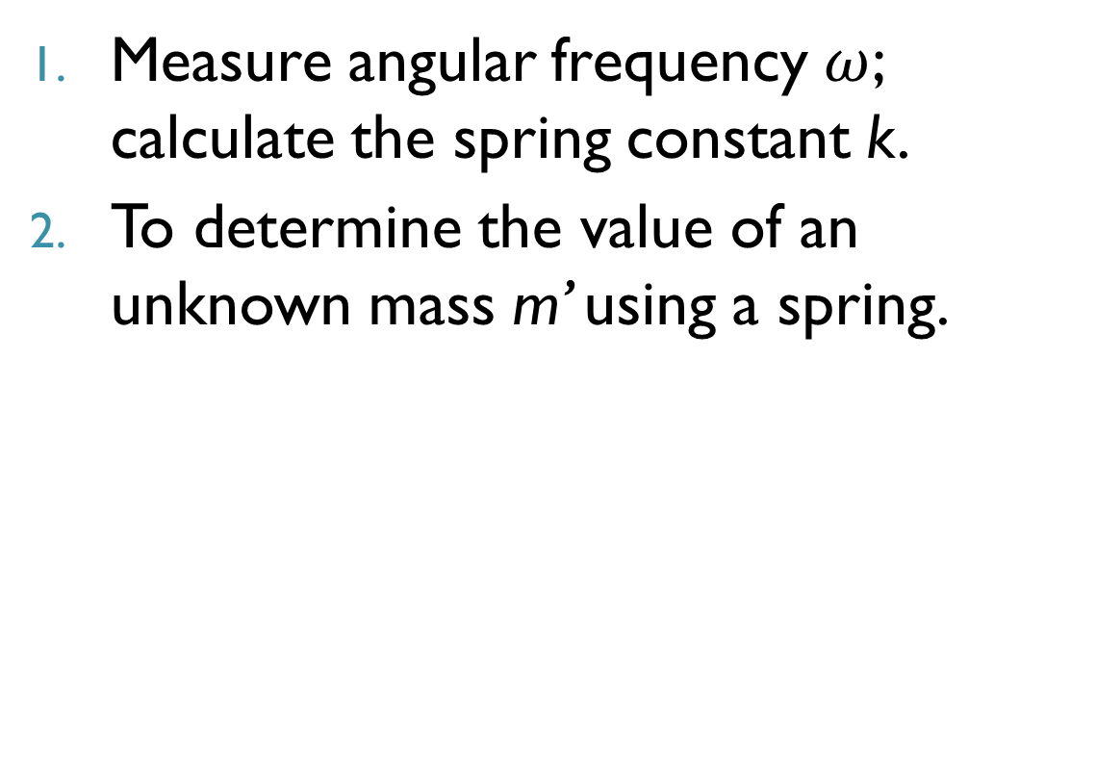
Objective
Measure angular frequency $ω$; calculate the spring constant k.
To determine the value of an unknown mass m’ using a spring.
source:
Youtube

Slide 4
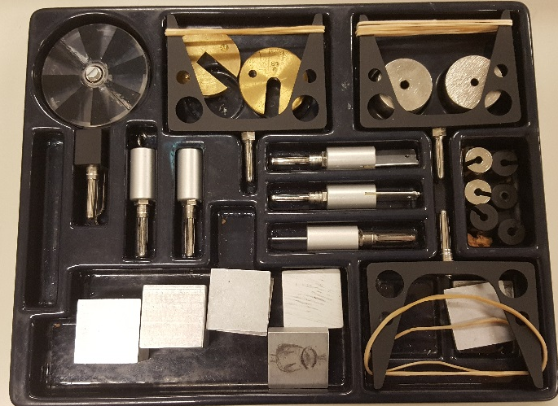
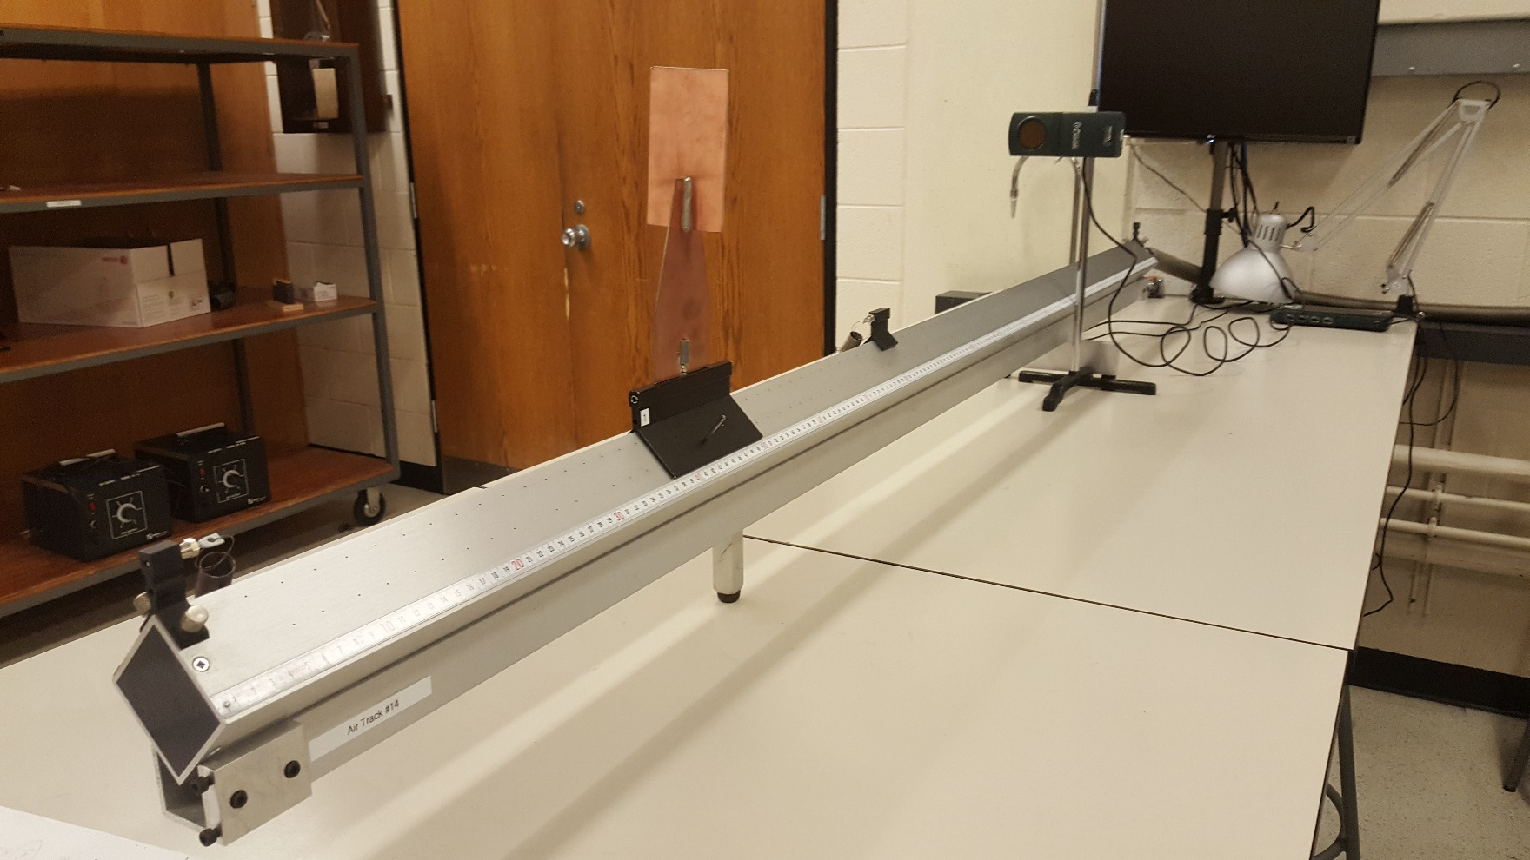
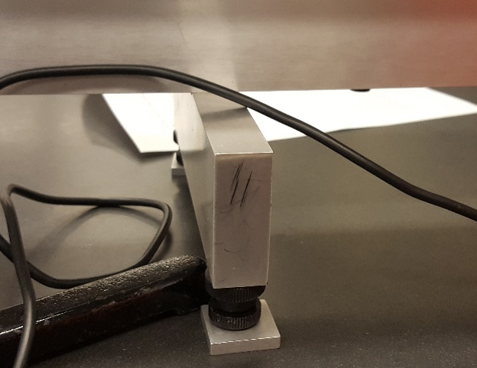
Equipment
Return all the used pieces to the box
Level the track horizontally and sideways (how and why?)
use aluminum shims if needed, screws are only for fine adjustments
Notes:
How: turn on air pump→ put the glider on the air track, if not leveled, due to gravity, the glider will move towards one end; if it’s leveled, the glider will not move and in the vertical direction the gravity of the glider equals to the reaction force from the air track;

Slide 5
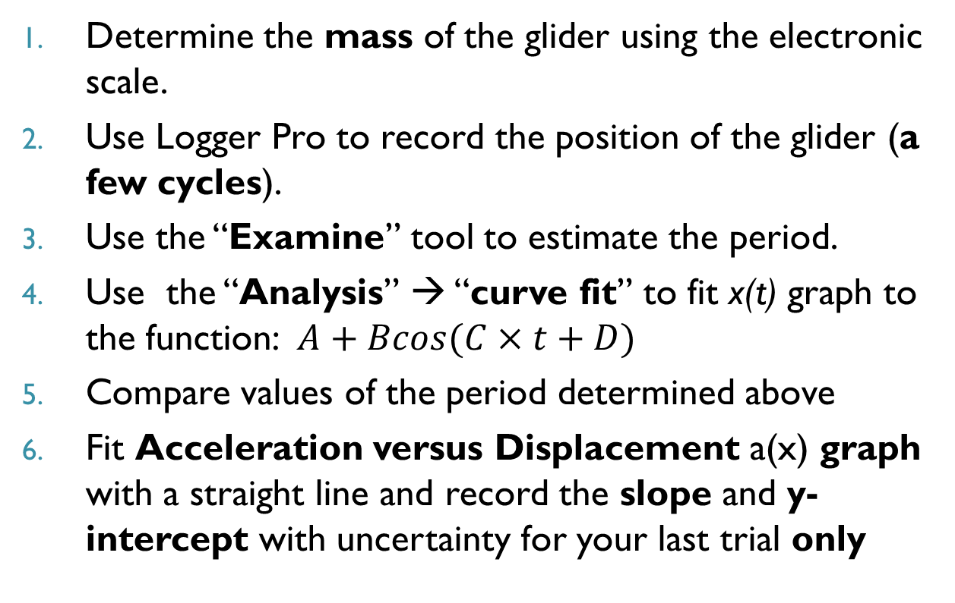
Procedure – Part 1
Determine the mass of the glider using the electronic scale.
Use Logger Pro to record the position of the glider (a few cycles).
Use the “Examine” tool to estimate the period.
Use the “Analysis” → “curve fit” to fit x(t) graph to the function: $A+Bcos(C×t+D)$
Compare values of the period determined above
Fit Acceleration versus Displacement a(x) graph with a straight line and record the slope and y-intercept with uncertainty for your last trial only
Notes:
Remind them A (zero offset),B (amplitude), C (angular frequency), D(initial phase) if needed

Slide 6
Procedure – Part 2
Add an additional mass and repeat your analysis with x(t) graph to determine angular frequency and a(x) graph to determine slope and y-intercept
Measure the additional mass using the mass balance.
Estimate the uncertainty in Each Case
Notes:
Remind them A (zero offset),B (amplitude), C (angular frequency), D(initial phase) if needed

Slide 7
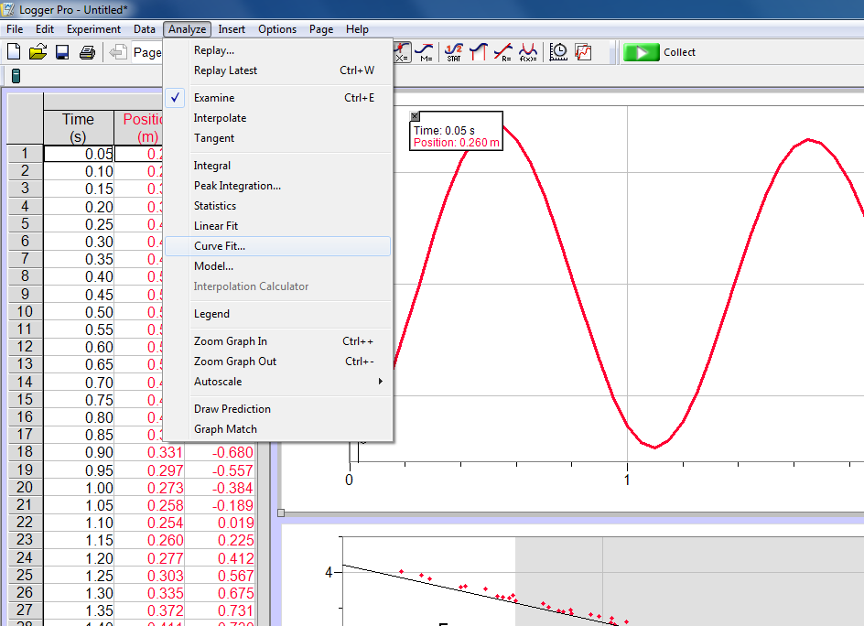
Procedure
Go to Analysis/ Curve fit

Slide 8
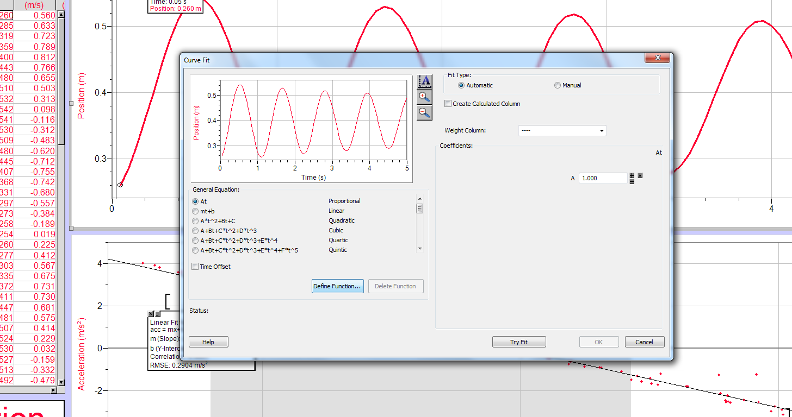
Procedure
Go to: Define function

Slide 9
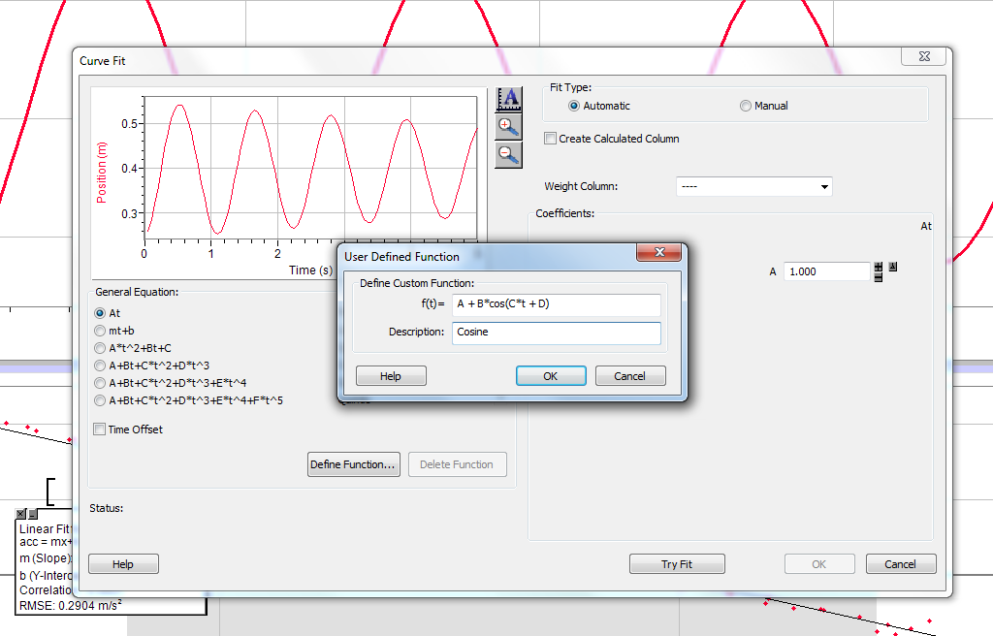
Procedure
Enter the formula: A+(B*cos(C*t + D))

Slide 10
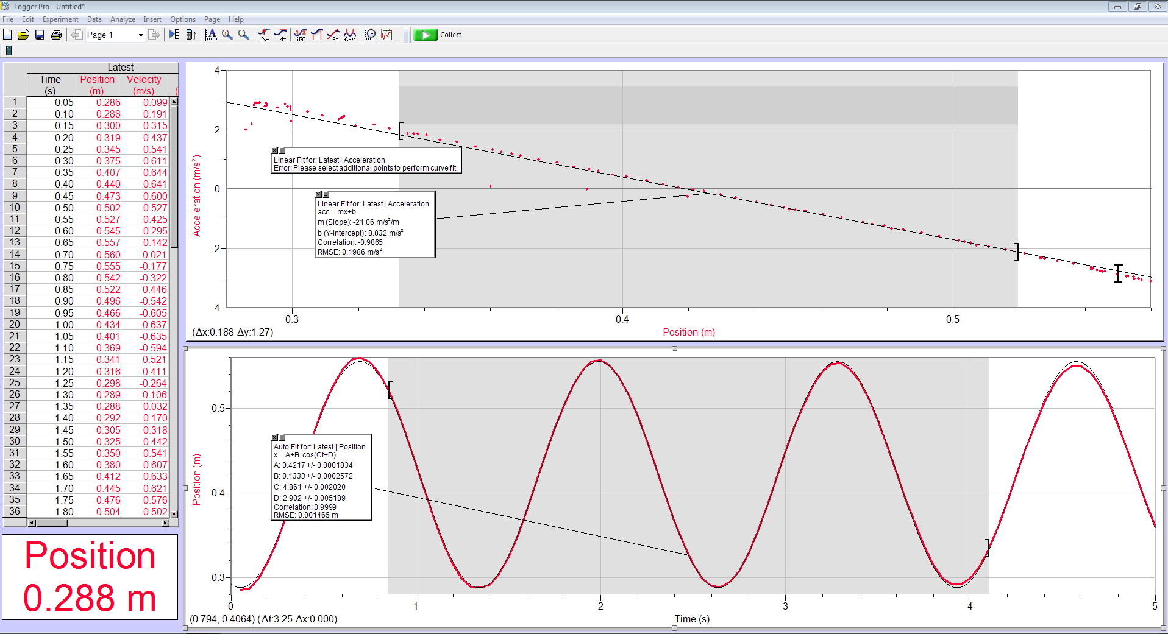
Procedure
Notes:
Change x and y axis

Slide 11
Procedure Key Points
Cosine function curve fitting should be done five times (do the experiment five times) in order to get the standard deviation of the mean as your uncertainty. Only the absolute value of your Constant C, which is your angular frequency, should be used for calculation.
The “Examine” tool manually determines the period using the cursor. The uncertainty is just your data time resolution. Experiment → Data Collection
Notes:
Sample Standard deviation but not population sd
Break down to 2 slides
Experiment → data collection

Slide 12
Procedure Key Points
In analyzing a(x) graph, use the curve fitting tool. There is a line function to fit your data, and it gives you the uncertainties for slope and intercept
Add only one additional mass (~ 50 g) to each side of the glider

Slide 13
Analysis
Calculate k_{effective} and individual spring constant k from both x(t) and a_{x}(t) analysis, propagate uncertainties
Compare these two values of the effective elastic spring constant
Calculate the value of the additional mass m’ based on the effective spring constant obtained and compare it with the measured one from the balance (show your calculations)

Slide 14
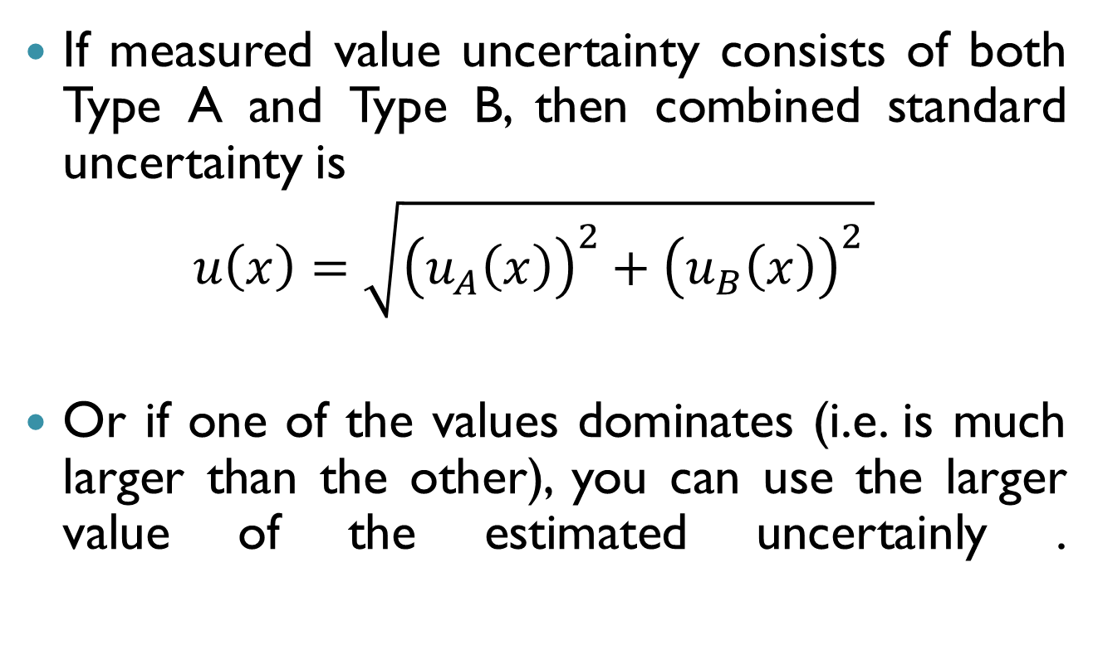
Combined standard uncertainty
If measured value uncertainty consists of both Type A and Type B, then combined standard uncertainty is
$$u\left(x\right)=\sqrt{{\left(u_{A}\left(x\right)\right)}^{2}+{\left(u_{B}\left(x\right)\right)}^{2} }$$
Or if one of the values dominates (i.e. is much larger than the other), you can use the larger value of the estimated uncertainly .

Slide 15
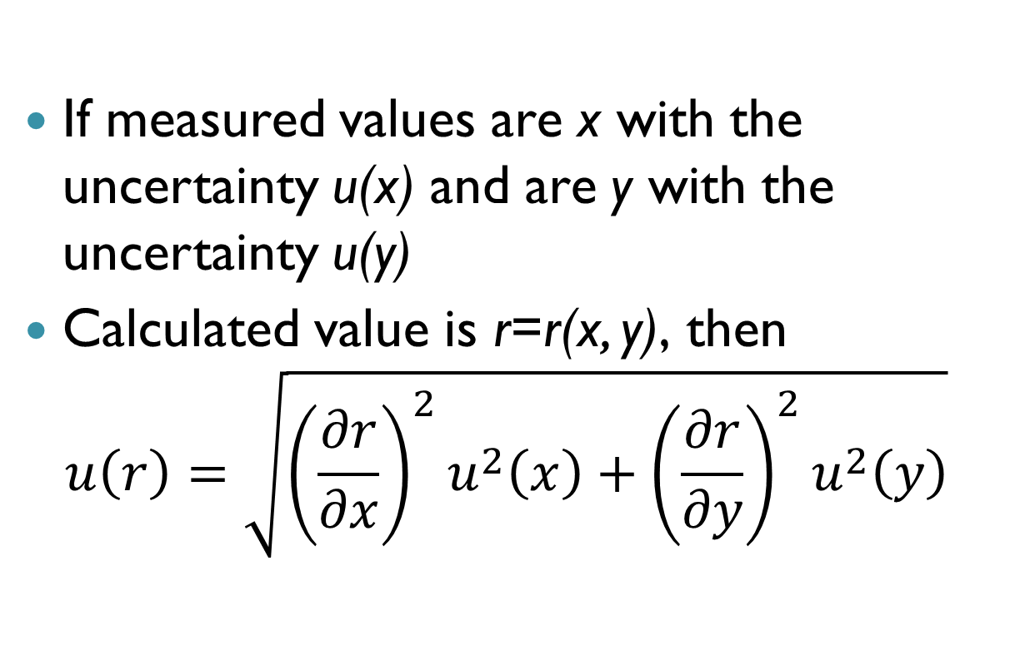
Propagated standard uncertainty
If measured values are x with the uncertainty u(x) and are y with the uncertainty u(y)
Calculated value is r=r(x, y), then
$$u\left(r\right)=\sqrt{{\left(\frac{∂r}{∂x}\right)}^{2}u^{2}\left(x\right)+{\left(\frac{∂r}{∂y}\right)}^{2}u^{2}\left(y\right)}$$

Slide 16
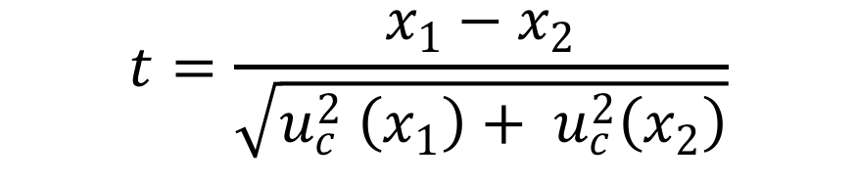
Comparing Two Values
In case we have two measurements x₁ and x₂, how can we compare:
Small value (<2) of |t| means x₁ and x₂ are very similar
Large value (>2) of |t| means x₁ and x₂ are very dissimilar
$$t=\frac{x_{1}−x_{2}}{\sqrt{u_{c}^{2} \left(x_{1}\right)+ u_{c}^{2}\left(x_{2}\right)}}$$
For more information please see pages 9 & 10 of “Measurement Uncertainty” on D2L

Slide 17
Before you leave
Submit your raw data template to the Dropbox! (Must be submitted within one hour of lab completion)

Slide 18
Laboratory report
Title of experiment, date, partners’ names, TA’s name, lab section
Objective
Method (include the equation)
Data (Table)
Analysis
Discussion
Conclusions

